Slide 1
Council Program Events: How They Help You
November 21, 2020
Rob Boehm
Scoutmaster – Troop 75 – Mentor, Ohio

Slide 2
Objectives:
IDENTIFY
At the end of this course, you will be able to identify areas in which your unit can benefit from attending and/or staffing a Council Program Event;
RESOURCE
You will have resources to help you find opportunities to participate in and/or staff a Council Program Event;
WITNESS
You will hear from real live people who have participated in and staffed events and see what they have to say!

Slide 3
THE 5 W’s OF COUNCIL PROGRAM EVENTS!
These 5 W’s will help you to see that when you miss a council program event, you miss a lot!!!
WHO DOES THIS BENEFIT?
WHAT EVENTS ARE THERE?
WHY WOULD I DO THIS?
WHERE CAN I FIND INFORMATION?
WHAT DO THE ACTUAL PEOPLE SAY?

Slide 4
WHO?: Who Benefits From Council Program Events??
This Photo by Unknown Author is licensed under CC BY-SA

Slide 5
All Divisions of Scouting Benefit In At Least One Way:
PARTICIPATION
STAFF (YOUTH LED)
Cub Scouts, Scouts BSA & Venturers can benefit from participating as an event attendee.
Opportunity to Make New Friends with Other Unit Scouts
Opportunity to Experience Program Elements Never Done Before
Opportunity to Develop or Enhance Scout Skill Sets Presented at the Event
Opportunity to Stay at a New Camp or Campsite!
Generally Scouts BSA & Venturers Will Benefit Most Here:
Opportunity to Recruit New Youth into Your Unit
Opportunity for Your Youth to Lead a Specific Skill Set or Game
Opportunity for Public Speaking & Presenting
Opportunity to Join Other Units in Staffing Events – Making New Friends.

Slide 6
WHAT?: What Council Program Events Are Available to Attend or Staff?
CUB SCOUT EVENTS
SCOUTS BSA/VENTURER EVENTS

Slide 7
THERE ARE SO MANY EVENTS THROUGHOUT THE YEAR – IT WILL BE HARD TO CHOOSE JUST ONE
CUB SCOUT EVENTS
SCOUTS BSA PARTICIPATION
SCOUTS BSA STAFF
Webelos Woods
Carnival Overnighter
Holidays At Camps
Cub Scout Virtual Adventures for Dens
Cub Winter Fun Day
Tough Cubbers
Red White & Boom
Resident & Day Camps
Camporee
Klondike
Merit Badge University
Silver Screen
Virtual Merit Badges
Red White & Boom
Summer Camp
NYLT
OA EVENTS
Webelos Woods
Klondike
Carnival Overnighter
Cub Winter Fun Day
Tough Cubbers
Camporee
Resident Camps
Summer Camps
NYLT

Slide 8
WHY?: Why should I attend or staff a council program event?
to prepare young people to make ethical and moral choices over their lifetimes by instilling in them the values of the Scout Oath and Law.

Slide 9
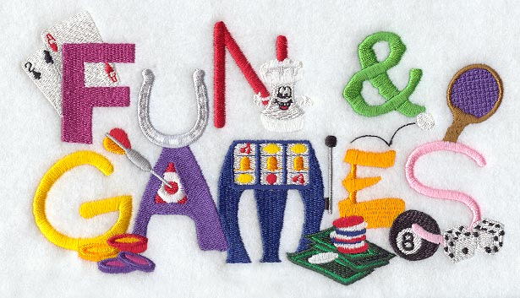
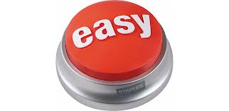
IT FULFILLS THE BSA MISSION AND:

Slide 10
WHERE CAN I FIND RESOURCES ABOUT EVENTS?

Slide 11
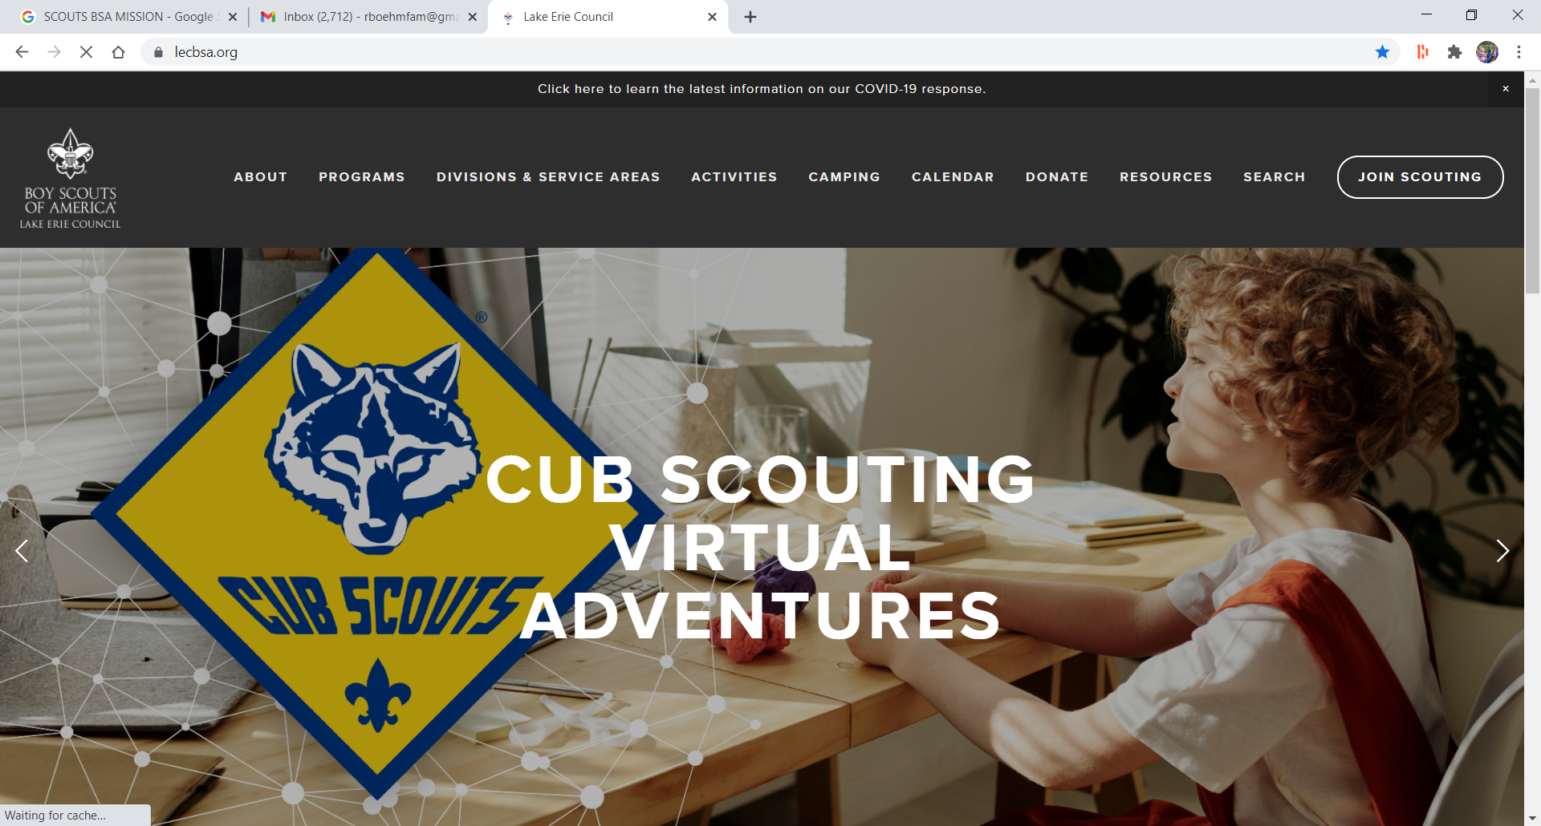

Slide 12
Cub Scouts:

Slide 13
SCOUTS BSA

Slide 14
PROGRAM QUESTIONS:

Slide 15
WHAT ARE THE PEOPLE SAYING?
Don’t JUST TAKE IT FROM ME – LET’S HEAR FROM THOSE WHO ATTEND AND STAFF REAL LIVE LAKE ERIE COUNCIL EVENTS:

Slide 16
INTERVIEWS WITH UNIT PARTICIPANTS & STAFF:
CUB SCOUTS
SCOUTS BSA
OTHER
LINK
LINK
LINK

