Slide 2
Lake Erie Council Recruitment & Product Sale Training

Slide 3
WELCOME
Notes:
WELCOME!
Houskeeping:
Restroom locations
Ask that you all sit by Chartered Org as best you can for the first part of training.
Take a minute to introduce yourselves around the table
You WILL receive access to EVERYTHING you see demonstrated today, including all slides, handouts, etc.
Much of the materials are in the folder you picked up at check in (anyone need one?)
We hope you participated in Check In today as that experience was modeled after a best method for recruiting and incorporates some tricks you can use at a popcorn kickoff, too. But we’ll talk more about those things at the breakout.
Before we begin, let’s introduce the members of the Lake Erie Council Field Team that are with us today…
Brag: Last year, Lake Erie Council achieved growth in both membership and product sales, an accomplishment we have not had for over 5 years!
2023 Membership Growth: As a Council, we ended the year with over 6500 kids in Packs, Troops, Crews, and other Units like yours!
Popcorn/Syrup: By the end of our product sale period, we sold over $950,000 in popcorn and syrup, keeping over $665,000 of that to support local Scouting!
And we are already building on that success in 2023, having already experienced 6 months of membership growth as of June 30!!
We are THRILLED to have all of you here to help continue that growth in membership and product sales in your home unit!

Slide 4
WHAT’S NEW?

Slide 5
National BSA Fees
Notes:
These next few items are for informational purposes…this is what the national BSA fee structure will be beginning Aug 1.
Each fee grouping includes one-year of registration and 12 months of insurance coverage.
Youth membership fees are increasing $5 for the year; adult fees are increasing by $15.
Folks who serve ONLY as a MB Counselor must now pay $25 for registration and background checks; registered adult leaders (in a Unit position) who also serve as an MB councelor, need not pay more than their $72 annual fees.

Slide 6
National BSA Fees
Notes:
There is still the “flat” $25 new member fee for anyone who has NEVER been registered with the BSA.
Units will still pay an annual recharter fee of $100; and Scout Life magazine is an optional $15 subscription for 12 issues.
While there are a LOT of questions, I want to assure you that we will be providing a detailed series of trainings focused on these changes in SPRING 2024.

Slide 7
National BSA Fees
NO PRO-RATED FEES: All new youth and adult members who join Scouting will be enrolled in a 12-month membership cycle ANNUAL RENEWAL ON INDIVIDUAL ANNIVERSARY DATE: Members will renew annually during the MONTH they originally joined. RECHARTER 2023: Existing members will renew their membership during their normal registration/recharter cycle. RECHARTER 2024: Existing members’ Anniversary date will be their unit recharter month; new members (who join after Aug 1 2023) will renew during their anniversary month. NEW MEMBER added in AUGUST: $117 (registered thru July 2024)
Notes:
NEW MEMBER added in JULY: $68.50 (registered thru Dec 2023)
NEW MEMBER added in AUGUST: $117 (registered thru July 2024)
Your Recharter in 2023 will NOT be changed; you will complete recharter as you have in recent years, paying for the majority of your members. Anyone added in August will simply show as “pre-paid” and will not charge you. The major changes will be experienced in fall of 2024, and we will be ready.
That being said, here are 3 facts that may help put some of your minds at ease:
Units WILL BE ABLE TO CONTROL how renewal and payments occur, with the option to deactivate parent payments in favor of paying as a Unit.
Auto-payment will be an available option for both families/parents and Units, depending on how renewal is managed.
Communication will come from both the Council Staff and from National BSA at least 60 days prior to expiration and will continue until a member is renewed or dropped.
I promise, more info in Spring 2024…if we spend too much time here, we will have no time for all the other stuff that WILL impact us this fall, so let’s move on!

Slide 8
BSA Barriers to Abuse Update
[(Effective September 1, 2023) Two registered adult leaders 21 years of age or over are required at all Scouting activities, including all meetings. There must be a registered female adult leader 21 years of age or over in every unit serving females. A registered female adult leader 21 years of age or over must be present for any activity involving female youth or female adult program participants. Notwithstanding the minimum leader requirements, age and program-appropriate supervision must always be provided. All adults staying overnight in connection with a Scouting activity must be currently registered as an adult volunteer or an adult program participant. Adult volunteers must register in the position(s) they are serving in. Registration as a merit badge counselor position does not meet this requirement. See FAQ for list of approved adult registration fee required positions. Limited exception below for Cub Scout overnight Programs.
Notes:
Another FYI reminder…
Effective Sept 1, stricter guidelines will be in place related to adult registration and who can provide leadership on overnight outings.
Simple rule: If you’re staying overnight on an outing for kids in a Troop, Crew, or Ship, you MUST be registered. If you are overnight with Cub Scouts, you must be a parent/guardian of a kid who is camping that weekend, or you must be registered.

Slide 9
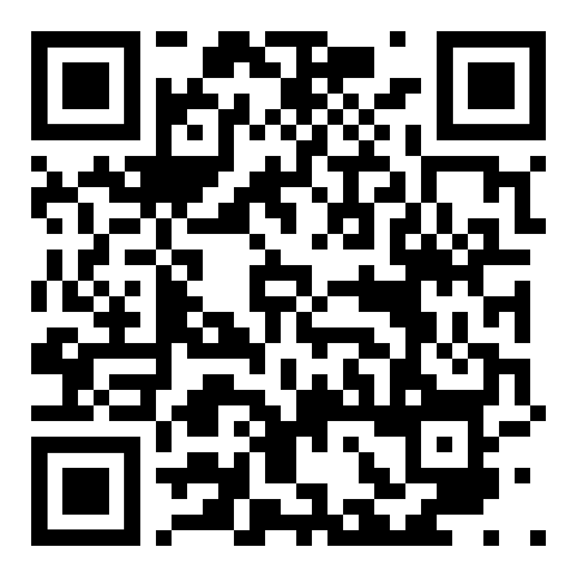
BSA Barriers to Abuse Update
Cub Scout Programs – Overnight Exception: Cub Scout parents or legal guardians taking part in an overnight Cub Scout program with their own child or legal ward are not required to register as leaders. All adults must review the “How to Protect your Children from Child Abuse: A Parent’s Guide” that can be found in the front of each Cub Scout Handbook. In addition, the parent or legal guardian must be accompanied by a registered leader at any time they are with youth members other than their own child/ward. All other overnight adults must be currently registered in an adult fee required position.
Notes:
Simple rule: If you’re staying overnight on an outing for kids in a Troop, Crew, or Ship, you MUST be registered. If you are overnight with Cub Scouts, you must be a parent/guardian of a kid who is camping that weekend, or you must be registered.

Slide 10
ACE Education Savings Program
Ohio Afterschool Child Enrichment (ACE) Educational Savings Account
$1000 per child for out-of-school educational programs…like SCOUTING!
More than 2/3 of our local families are likely eligible:
Income: Families that make less than 400% (yes, FOUR TIMES) the Federal Poverty Level
Gov. Program Participation: Families who are already enrolled in a Gov Support.
Residency: Families that live within a school District prone to absenteeism.
Notes:
Now, for some GOOD NEWS!
Have you heard of ACE?
This is an OHIO STATE PROGRAM, not a BSA or LEC thing.
Money is available to families based on meeting ONE of the following criteria…

Slide 11
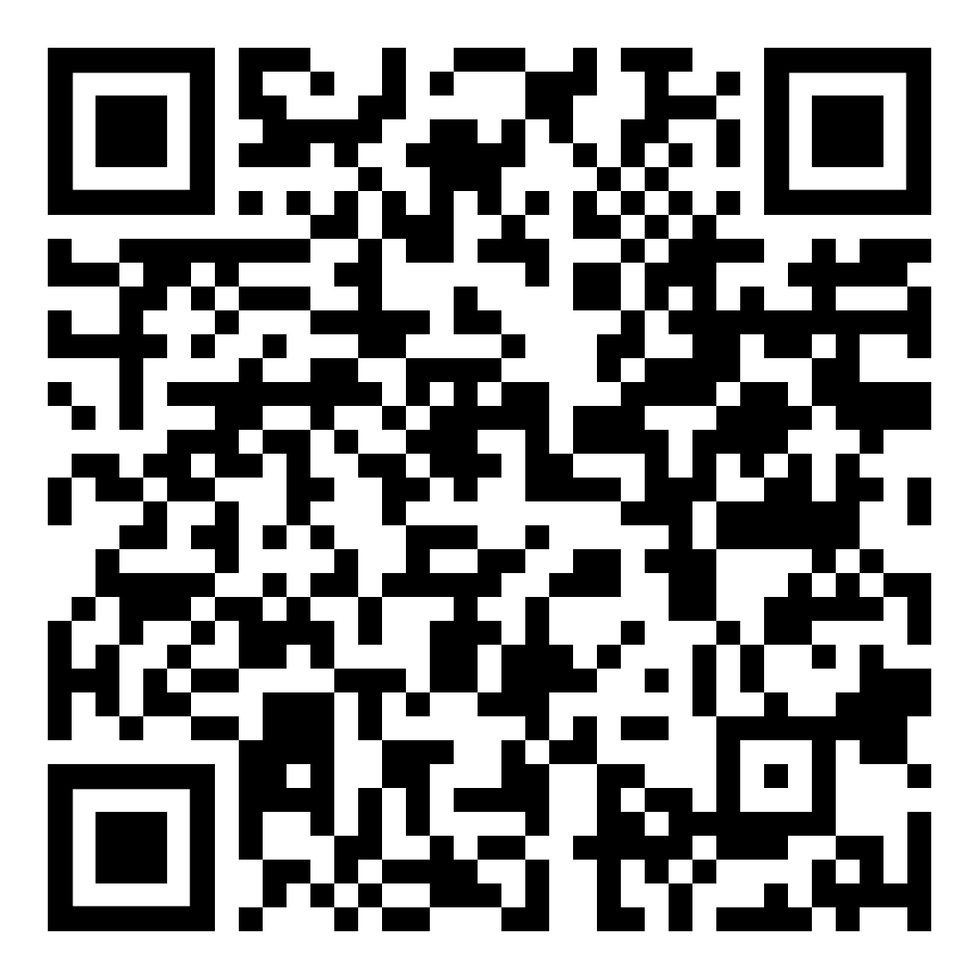
ACE Education Savings Program
Notes:
You do NOT need to be attending a school in the district, or even attending public school…you just have to LIVE IN THE BOUNDARIES of the District and you automatically qualify.
This QR takes you to the eligibility requirement details, but many, many families will automatically qualify based on geography alone.

Slide 12
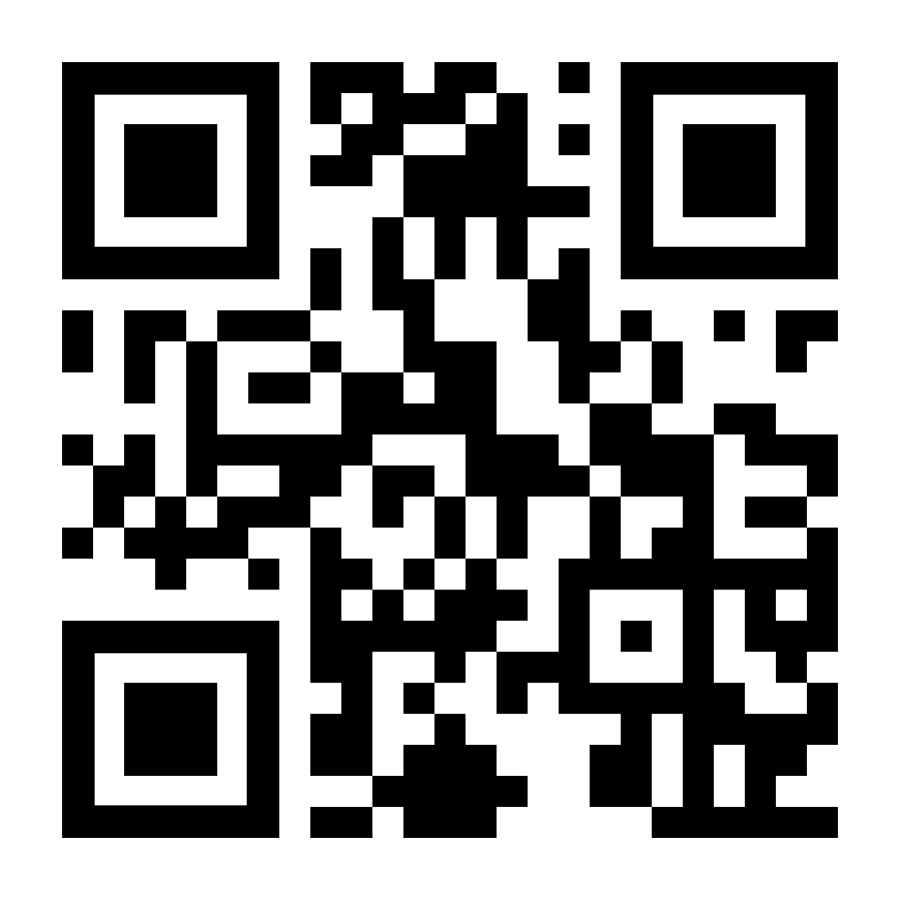
ACE Education Savings Program
How families access this account:
Visit https://www.aceohio.org/ and click “Apply Now!” to complete an application.
After processing and acceptance, families set up their account and can begin submitting receipts.
Submit documentation/receipts for eligible expenses and receive reimbursement within 2-4 weeks.
Notes:
Our advice, and the advice we have gotten from the folks at ACE is APPLY! Everyone in the state should apply, even if they don’t think they qualify.
There can be a 2 week processing period for applications, so apply soon!
However, receipts for qualifying expenses (which we will look at in a minute) can pre-date your application, so long as it is within the program year of July 2023 – June 2024.
This QR takes you to the ACE page where the application link lives.

Slide 13
ACE Education Savings Program
What Scouting expenses ARE ELIGIBLE:
Annual National BSA youth registration fee of $80. UNIT FEES/DUES are NOT eligible at this time.
National BSA New Member Fee of $25 (if applicable).
Insurance Fee of $12.
Day Activities, such as Merit Badge Universities and Council weekend events where an overnight stay is not required.
Notes:
READ THESE: This is what can be reimbursed through ACE.
NOTE: Only Day Activities are eligible according to the State legislation…the cost associated with OVERNIGHT CAMPOUTS are not eligible.
BUT…all weekend events hosted by LEC will be offered as ACE eligible activities, since the FEES PAID cover program on Saturday ONLY! Tent and Troop Lodge Camping will then be offered either FREE or at an additional (non-reimbursable) charge, allowing families to submit receipts for the event cost and get reimbursed according to ACE.

Slide 14
ACE Education Savings Program
What Scouting expenses ARE NOT ELIGIBLE:
Council-sponsored events requiring overnight stay.
Handbooks or Merit Badge Pamphlets
Adult Leader Registration Fees
Activities and events organized by the Unit (that are not Council-sponsored events)
Cost of supplies for Unit meetings or activities (such as supplies for a Den meeting or merit badges.)
Any camping equipment or electronics.
Uniforming or insignia.
Travel expenses.
Notes:
Equipment and uniforming, along with overnight outings, are specifically named in the Ohio Legislation as NOT ELIGIBLE for ACE reimbursement.
Adult fees are also not eligible at this time.

Slide 15
ACE Education Savings Program
What does this mean?
Scouting registration is essentially FREE for over 2/3 of the families you will talk to this fall.
Between $200 and $300 in annual events/activities will also be FREE for families to access.
ALL FAMILIES SHOULD BE ENCOURAGED TO APPLY!

Slide 16
LAKE ERIE COUNCIL
THOUGHT PROVOKER:
“Why are YOU involved in Scouting?”
Notes:
ASK:
I want you to take a moment and think about this question. The answer might be as simple as “To support my child” or “because its family tradition.” For others, it may be far more complicated than that…try for a moment, to answer this question in your own mind. Keep thinking about that as we now go into our breakouts…

Slide 17
LAKE ERIE COUNCIL
BREAKOUT!
Notes:
Recruitment Location:
Product Sale Location:

Slide 18
LAKE ERIE COUNCIL
Recruitment Training

Slide 19
LAKE ERIE COUNCIL
Be Prepared

Slide 20
Make a Plan
Plan, Plan, Plan
Calendar for at least 3 months following join event
Open volunteer positions
Identify public visibility opportunities
Who can help? Give them a specific job.
Packs and Troops should COLLABORATE!
Who attends? Who DOESN’T?
Make sure the focus is on RECRUITING.
Sometimes, less (people) is more (effective.)
Notes:
When you calendar for 3 months, you should produce that as a HANDOUT for families who attend your event.
May sure your plan for the event included active COLLABORATION between Units in the same Chartered Org.
Who attends and who doesn’t? Sometimes, having a big exciting pack meeting is a great sales technique, but sometimes it can be overwhelming for new families. You may consider just having a small group of leaders and a few Scouts (ideally some den chiefs or affiliated Troop members) to manage the event.
"Taking Parent to Helper and Helper to Leader" (HANDOUT)
Position List with BLANKS for prospect names (Helps to Plan your Plan)

Slide 21
Goal Setting
Set a GOAL!
Look closely at things like Scouts that will be aging out and how many incoming Scouts you need to keep the unit sustainable.
Consider "Ideal" Den/Patrol Sizes
Notes:
Setting a specific membership goal helps you evaluate where the needs are in your unit. Membership goals should be specific to help determine how many youth to target and for which grades.
“Ideal” Den/Patrol size is between 8 and 10; some dens/patrols may succeed with as few as 5 or 6, or as many as 12 to 15, but too FEW Scouts results in less fun and fellowship (and fewer parent resources) and too many can create (more) chaos and impacts program (leadership opportunities for Scouts BSA are impacted negatively on both ends of that spectrum.

Slide 22
Unit Pin Update
Make sure you update your unit pin and use your custom QR code on all marketing materials
“How to UPDATE YOUR PIN”
Make your pin informative and provide multiple ways for people to access information about the unit
Phone, email, and unit website/Facebook page should all be included. Mention if texting is preferred.
Notes:
WHAT IS A UNIT PIN?
Your Unit Pin is the information you are providing to the general public when they seek out a Scouting Unit in the area. Your Pin can be a great sales tool…as long as it up to date!
Here’s what a BEASCOUT pin looks like (click icon in upper right corner)
Look up a zipcode (use yours unless someone is brave)
Take a look at the info provided.
Now, let’s listen to a Scouting Pro from another Council talk a bit about how to update this vital tool.
Mention PIN UPDATES
Discuss what is IMPORTANT INFORMATION TO SHARE:
-
SHOW VIDEO HERE
REQUEST PLAN/BUDGET
Provide SAMPLES (handout)
Send template as an AFTER ACTION item

Slide 23
Notes:
IF VIDEO DOESN’T WORK, go back a slide and click the text “How to Update your Pin”
Your Unit Key 3 and Delegates have access to this function.

Slide 24
Promotion

Slide 25
Local Media Options
Local Town/City Newspapers
10 Best Practices
Student Publications
Business Windows
PTA/PTO Newsletters
Bulletin Boards
Church Bulletin
Business/Town Marquee
Notes:
This is something you can (and should) start NOW! Reach out to your local contacts ASAP, especially to find out deadlines for submissions! Some publications require submissions up to 30 days prior to publication.
We would also LOVE to hear from you… Share contacts for local news outlets with your area Field Staff Executive; we can then use these contacts to provide additional content.
However, the BEST stuff will always come from you, so reach out to them NOW!

Slide 26
Social Media
BSA Social Media Guidelines
Lake Erie Council Posts
SHARE SHARE SHARE!
Facebook Events (yours and LEC)
Geofencing
Custom Videos
Families as “Influencers”
Notes:
Council Managed Targeted Marketing and Geofencing...YES
- Form to File (created thru JotForm)
- ONE ad
- 14-day lead time
If this is NOT your strong suit, don't focus your efforts on this!
ACTION ITEM: Get your families to LIKE and SHARE the things you have going on, LEC posts, etc. And then have them POST about their Scouting experiences and TAG your Unit social media.
"What Social Media is out there?" (HANDOUT)
- List of Social Media Outlets
- Target Age-Range and Demographics

Slide 27
Peer to Peer
Peer-to-Peer Cards
Activity Uniform (Class B) day at school
Personal invitations to sports teammates or dance class attendees
“Bring a Buddy” events
PARENT TO PARENT
Notes:
"Tell a Story"
- Rachel's Daughter (video?)
"6 Essentials for Recruiting"
Parent to Parent – Use available business cards

Slide 28
Outside the Box
What are some unique ways you’ve recruited for your unit?
Notes:
Flier on the Pizza Box (Marco's)
Post-it Note Gathering Activity
Promo Ideas
How can we HELP?!
Event Ideas
Recruiting Goal

Slide 29
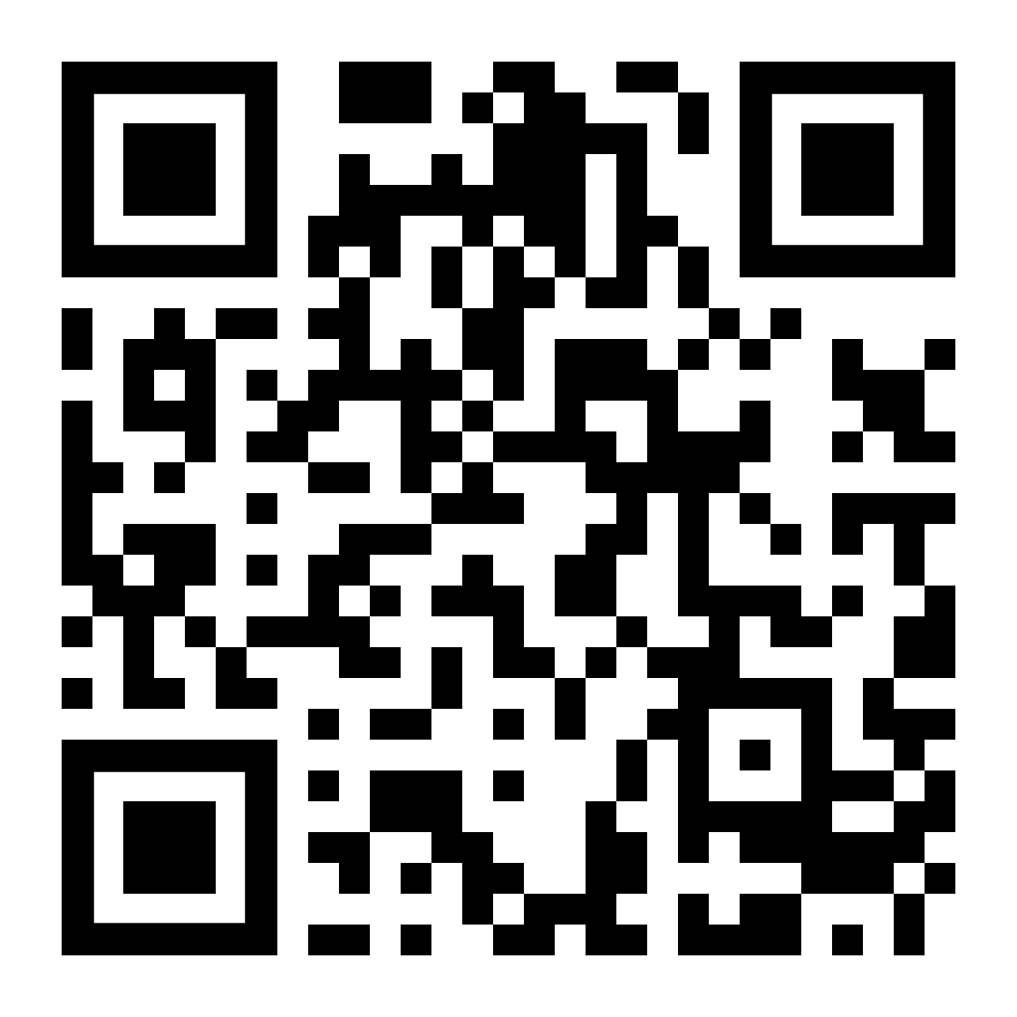
Online Resources and Tools
Membership resources website: lecbsa.org/membership-resources
Fliers
Peer-to-Peer Cards
Promo Giveaways
Resource Requests
What resources are AVAILABLE?
Substitutions
Customizable Videos
Notes:
Resources:
14 day lead time
Review each item, and give a specific example of how it was used in our demo

Slide 30
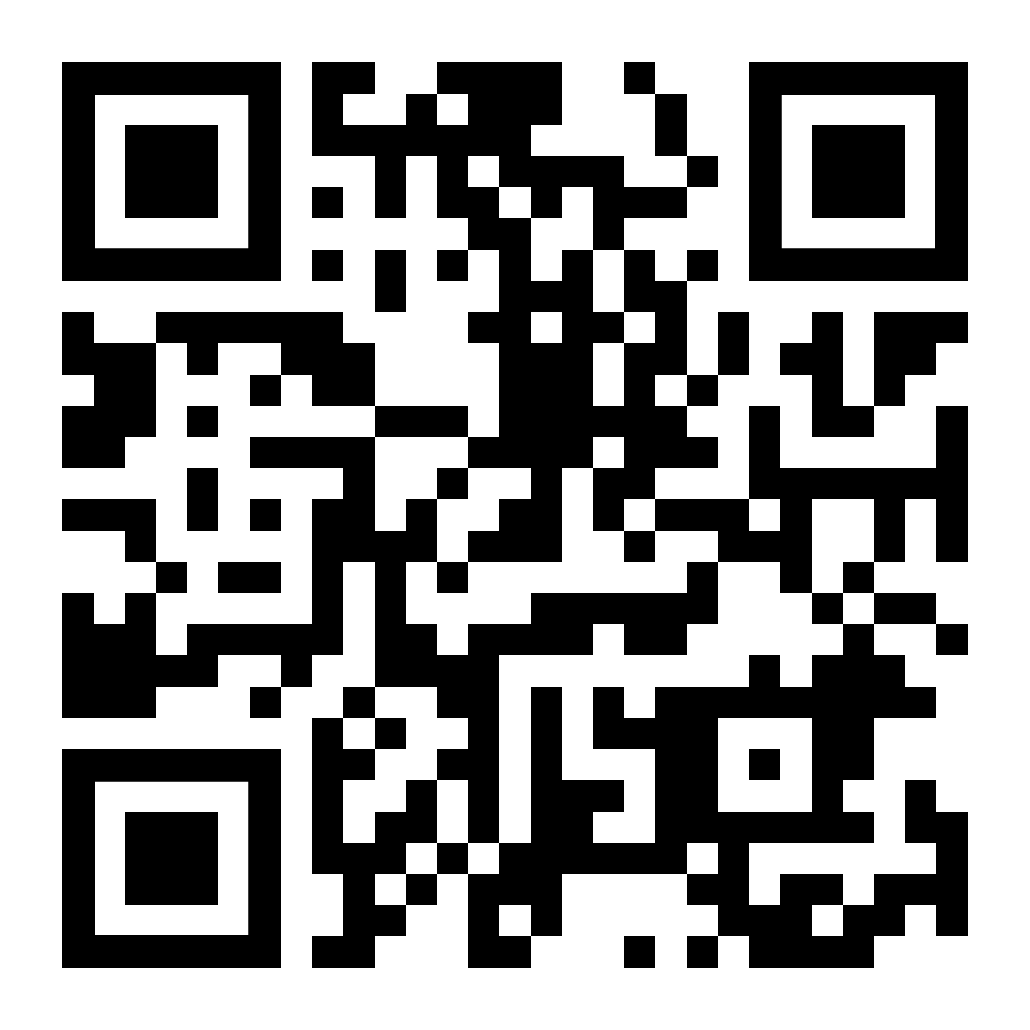
BSA Brand Center
Notes:
Review brand center…click image to visit site.
https://scouting.webdamdb.com/bp/#/

Slide 31
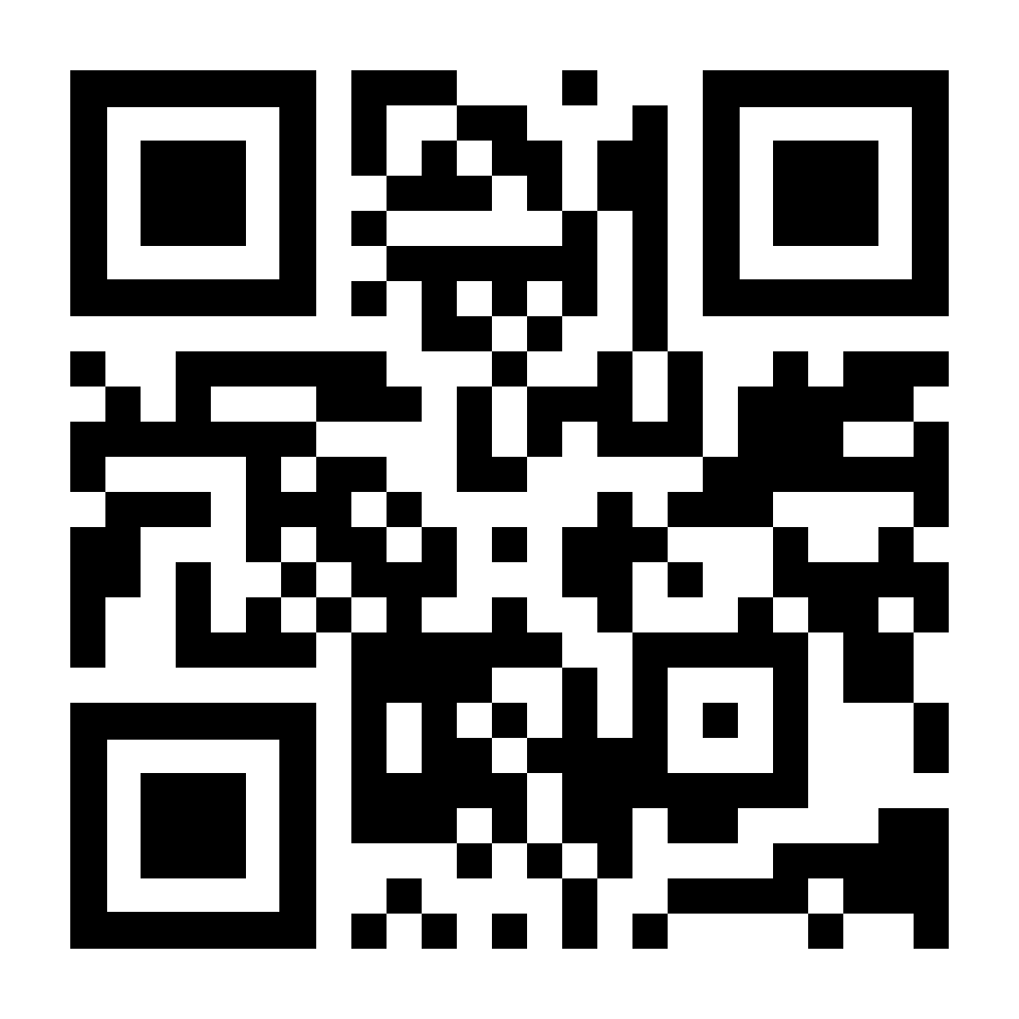
My.Scouting Tools
BeAScout.org
Invitation manager
Application manager
Using the Online Application
Online Application Approval
Notes:
Visit BeAScout, look up a Pack in attendance
Then visit my.scouting and demo a pin update, reviewing fields that I priority
Invite Manager…show WHERE it is and the simple click thru of communicating thru it
App Manager…show WHERE it is, the simple approval steps, and mention WHO is an approver

Slide 32
Overcoming Objections
and “Closing the Sale”

Slide 33
Overcoming Objections
It costs too much!
Product Sale
ACE
Community/Chartered Org Funding.
Value for what you're spending: 1 year of programming can be broken down into monthly cost, which can be broken down even more.
We don't have the time…
“This pack may not be on a good night for you, but if you head to beascout.org, you can find other packs in the area that meet on different nights!”

Slide 34
Overcoming Objections
I wasn't a scout growing up, I just don't see the value.
We can help teach kids valuable life lessons that they can't always learn elsewhere.
Scouting is designed to give you “scheduled” time with your kid!
No, she's gonna be a girl scout. That's where girls belong…
Cub Scouts is open to girls as well!
Many girls do BOTH!
Notes:
…Our kindergarteners are learning how to run a business and learning those vocabulary and speech skills while selling popcorn. They're also learning to face rejection when people say no. Thats barely scratching the surface of what we can give your child.
…because Scouting relies on your involvement, it also means that you have a weekly/monthly appointments on your calendar for quality time with your child.
…they learn right alongside the boys. It's great for parents of multiples. GS and BS are two very different programs. Can I tell you a bit more about the BSA program and why we are different? I may recommend checking out and talking to a local Girl Scout leader as well as coming to visit our pack one night? You may be surprised what is a better program for your child.

Slide 35
Overcoming Objections
No, not interested…
“Thank you for your time and if you have any further questions, here's my info and I would be happy to answer things for you.”
I hear about Scouting not being safe…
Often the “unsaid objection”
Barriers to Abuse / Youth Protection
Guide to Safe Scouting
“As a fellow parent, my children’s safety is extremely important to me…”
Notes:
…In Scouting, we have several “Barriers to Abuse,” including no less than two adults with no less than two kids, background checks, youth protection training certification for leaders and age-specific resources for youth built into their grade level program.”

Slide 36
The Application Process: Electronic & Paper
Working the ONLINE application process:
Where to go
Info Needed
What happens after it's sent?
Notes:
We will look at two short videos now on how this works…

Slide 39
The Application: Electronic & Paper
Information needed for paper applications
Having the correct information the first time, avoids needing to be called to fix things. It also means processing the application (and money) in a timely manner. Gets the Scout into a program and lets them get started at events that much sooner.

Slide 40
You don’t get a second chance to make a first impression!
GOOD FIRST IMPRESSIONS:
Handshakes
Eye Contact
Welcoming Smiles
Having an activity for the kids while parents get info – Make it Fun!
Positive! Positive! Positive!
BAD FIRST IMPRESSIONS:
Crossed Arms
On the Phone
Chewing gum/Eating
Disinterest
Lack of Organization/Late
Negative

Slide 41
After the Event

Slide 42
After your Sign-Up Event
Paper Applications:
Turn them in to a Council Professional or to the LEC Office ASAP
Delays in registration impacts insurance coverage, advancement, Scout Life
New ADULT VOLUNTEERS CANNOT SERVE in their role until an application is turned in and background check is completed.
Online Applications:
New Online Application MUST be approved on my.scouting Application Manager.
Prospective Families: Follow up within 48 hours.
Invite them to visit the next Pack or den meetings, answer questions, and ask for feedback.
Notes:
The 48 hours AFTER an event may be more important than the event itself!
Get the applications approved (and/or turned in) ASAP…new members will begin receiving benefits (insurance, Council communication, etc.) as soon as apps are processed.
All new families will receive a Welcome E-mail from LEC, which will include their ACE reimbursement guidance…a delay in processing could cost families money.
Folks who didn’t register at the event should receive a communication from your Pack a day or so after the Event, with reminders of upcoming Pack events and an “open invite” to attend one of them.

Slide 43
After your Sign-Up Event
Communicate!
Send all members (and your prospects) an e-mail each week for the next 3-4 weeks.
Activity Reminders
Calendar Updates
Training Dates
ACE Information
Parent Orientation Night
Hold a separate night, within 3 weeks of the Sign Up Event
Ideally BEFORE the next Pack Meeting
Could be in place of a September Committee Meeting
Notes:
Keep this communication going for the next few weeks. After 3 e-mails to prospects, share a final “if you change your mind, give us a call” and then discontinue reaching out. But DO NOT fail to communicate with new families frequently during their first 2-3 months…many families that leave a Pack or Troop do so because they “didn’t know what was going on.”
Hold a Parent Orientation night WITHIN 30 DAYS of your sign-up event. This will be your chance to share your Unit’s long-range plans, explain operations in details, and make the “volunteer” ask. Recruiting a Den Leader or new Committee Member at a Sign Up Night RARELY is as successful as doing it at an orientation for new families.

Slide 44
After your Sign-Up Event
Thank your Team:
Recognize your volunteers personally and consider thanking them publicly at a future meeting.
Ensure Training:
All new REGISTERED VOLUNTEERS should receive Youth Protection Training
Leaders should also complete online training for their role within 3 months.
All PARENTS should also be encouraged to take YPT.
Keep Going!
Promote future meetings…many families may miss the sign-up event.
Notes:
Thank your team of volunteers PUBLICLY and OFTEN! Sometimes new families will see this recognition and want to be part of the team!!
Make sure new folks (registered or not) are aware of Youth Protection training and other options, online and in person. LEC website has a calendar with details for the next year’s worth of training available.
And DON’T STOP! Many of our most successful, active Units in the Council make a special effort to host quarterly recruiting events, where they invite new prospects to a fun summer activity, or spring service project. In fact, just using “JOIN SCOUTING” yard signs wherever you go as a Unit can create interest…if you are visible in public, put up a sign and get people talking!

Slide 45
…and ACTION!

Slide 46
What to do NOW!
Update your BEASCOUT.org pin.
Schedule your SIGN-UP Night.
Make sure your meeting location is reserved.
Promote through…
Local newspapers.
Chartered Org
Current Members (peer-to-peer & parent-to-parent)
Local Events
Request Additional Materials through LEC.
Notes:
These are the things you should ALL DO within the next 2 weeks to get a jump on growth this fall!!

Slide 47
What to do NOW!
Review your School Schedule
Participate in Scouting for Food
Units have successfully used this (and other LEC events) to recruit new kids!
Schedule a Unit Planning Conference (if you haven’t already!)
Check BEASCOUT.org leads (early and often!)
CONNECT WITH YOUR UNIT SERVICE EXECUTIVES!
Notes:
These are the things you should ALL DO within the next 2 weeks to get a jump on growth this fall!!

Slide 48
Meet the Team

