Slide 1
Outdoor Program Planning

Slide 2
Outdoor Program – who, what, where, why & when
WHO - Outdoor adventure is the promise made to young people when they join Scouting. Boys and girls yearn for outdoor programs that stir their imagination and interest. Who promised to take kids outdoors when recruiting?
WHAT - Do something appropriate for your audience.
WHERE – Anywhere! Right outside your front door, to across the globe (think World Scout Jambo 2023: its in Korea!)
WHY – Because nature is the ultimate classroom that demands students rise to the occasion.
WHEN – As often as possible.

Slide 3
Get your training first
“We are not a club or a Sunday school class, but a school of the woods.” BP
Get the appropriate training for the age group you will be leading. - Why do we build schools? to house humans that want to control the lesson and learning environment.
- Why do get so many trainings? Nature has it’s own agenda, and we need to be ready and prepared for that inevitable change of plans even though we have our own agenda.
Notes:
CS: Baloo
SBSA: Trek Safely
All: Hazardous Weather, Trek Safely, Wilderness 1st Aid, Safety Afloat, Safe Swim Defense, Climb On Safely
These trainings will be identified on a handout for participants, in addition to where the training is offered (in person or online).
“In Scouting, the world is your oyster, and there are a lot of dangers or other considerations that need to happen in order to successfully pull off an outing. Remember, Scouting is a volunteer-run organization, and it is the BSA’s promise to adult leaders to offer them the training resources necessary to make it a safe, positive experience for all. THANK YOU for all the work you do!”

Slide 4
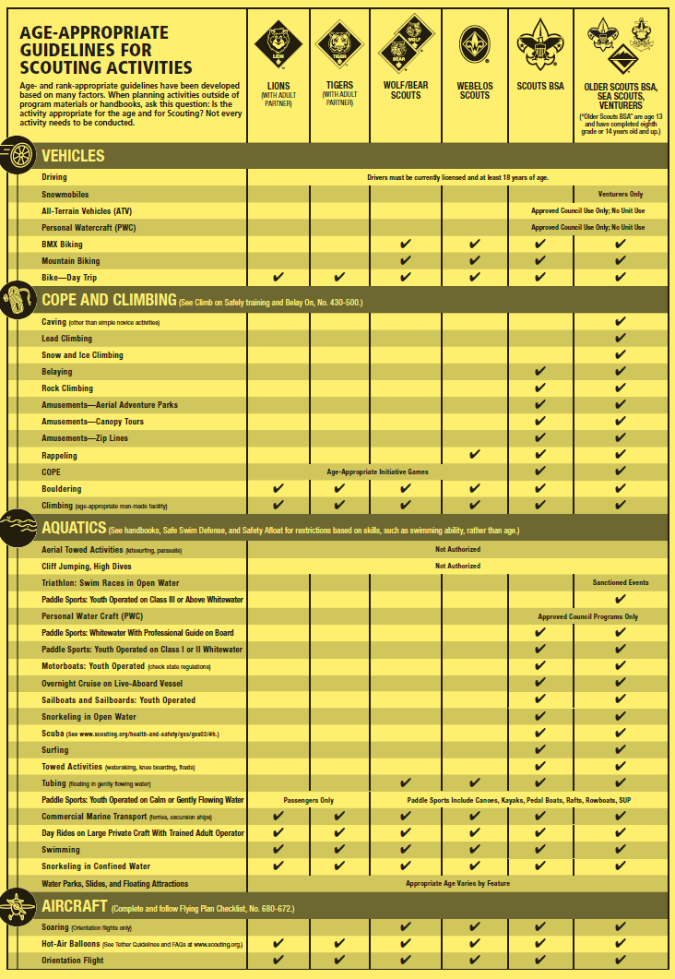
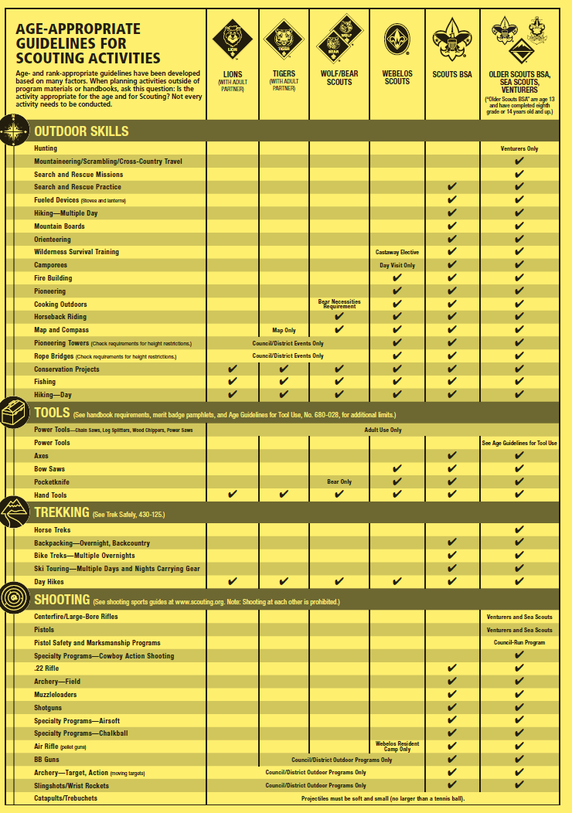
The Guide to Safe Scouting:
Example of activities:
Catapults / Trebuchets
Projectiles must be soft and small (no larger than a tennis ball)
Notes:
Handout will be printed and readable for participants.
“This is meant to be a frame-work for your great big world of outdoor adventures. When considering outdoor adventures, start by asking, ‘What do I want to do?’ Then, compare/look up the activity in the GSS to see what limitations/requirements there are for said activity.’

Slide 5
The Guide to Safe Scouting https://www.scouting.org/health-and-safety/gss/toc/
Use this as the tool to keep your scouts safer in the outdoors
Is it the Guide to No Fun?
Not at all, it is the structure to provide the best opportunity to give your scouts a good memory.
Prohibited activities page 39 – 43 of 110 pages
Notes:
“Hypothetical example: a Kindergarten Lion Scout is on a class V white water trip. Their skills aren’t that strong, because they’re only 5 or 6 years old, so they end up falling out of the raft and into the river, never to be seen again. That isn’t fun for them, their family, their friends, their teachers, anyone. That’s a tragedy.
Another hypothetical example: every time a Scout goes camping, he comes back with scrapes or scars or a black eye, and he explains how he spent all day running around with the other Scouts, playing with sticks throwing rocks at each other. That may be fun in the eyes of the Scout, if he isn’t too terribly injured, but it is NOT why his family signed him up. It’s not fun or safe, these activities are now a liability.
There are reasons the Guide exists, and it is to ensure Scouts stay as safe as possible. Without safety, there is usually damage or injury. Neither of those things are good for Scouts, and they prohibit a fun, positive experience.”

Slide 6
Guide to Safe Scouting Appendix
Use these checklists to help plan a safe outdoor program Motor vehicle and Driver checklist Campout Safety Checklist Event Safety Checklist Flying Plan Checklist
There are more….
Notes:
Motor Vehicle Checklist: https://filestore.scouting.org/filestore/pdf/MotorVehicleChklst_Update.pdf
Flying Plan Checklist: https://filestore.scouting.org/filestore/pdf/680-672(17)FlyPlanFillable.pdf
Campout Safety Checklist: https://filestore.scouting.org/filestore/HealthSafety/pdf/campout_checklist.pdf
Event Safety Checklist: https://filestore.scouting.org/filestore/HealthSafety/pdf/event_checklist.pdf
These will also be printed and handed to participants.

Slide 7
Cub Scouts
https://www.scouting.org/outdoor-programs/camping/cub-scout-outdoor-program/
Camping - Day Camp, Resident Camp - Family Camping - Pack overnights – council camps & charter partner - Webelos overnights
Other than camping – hiking, field trips, games, sporting events
Awards
Notes:
“Now this is generally what Cub Scout Outdoor adventures look like. Run by the parents/leaders of the Pack, it’s all family oriented.
Notice Webelos overnighters: Webelos are allowed to do the most in the Guide to Safe Scouting in the Cub Scout program: just check out the handout! This is true for Scouts of all ages as they get older and more experienced in the program. This means there is OPPORTUNITY for outdoor adventures to become more exciting and enticing for the youth, as well as their families.
All boundaries WITHIN the GSS should be explored to keep the Scouts’ experience as positive, fun, and new as possible!”

Slide 8
Scouts BSA
https://www.scouting.org/outdoor-programs/camping/scouts-bsa-outdoor-program/
Camping – monthly… - Weekend Overnights, troop or patrols - Camporees - Summer Camp - Council High Adventure / Nation High Adventure - Unit High Adventure
Other than Camping – day events, hikes, service projects, sporting events, 10 essentials…
Merit Badges and Awards
Notes:
“In SBSA, the focus changes from the occasional campout to a monthly campout. Additionally, this is youth-run and adult leader supervised. Rank Advancement and merit badges also encourage more outdoor activity than at the Cub level.”

Slide 9
Venturing Outdoor Programs
Everything from Scouts BSA plus
WITH GREAT ADVENTURE COMES GREAT RESPONSIBILITY
Hunting – unit level, guided trips
Search and Rescue – practice & missions
Horseback Riding Treks
Large bore Rifle and Pistol Shooting, competitions & events
Snowmobiles
Youth lead Unit Caving
Lead Climbing / Snow & Ice Climbing
Youth Operated White Water rafting up to class 3 rapids
Notes:
“And in Venturing, the limits are pushed out even further. With the proper training, paperwork, and prep, all of these activities are allowed for Venturers only within the GSS.”

Slide 10
Awards Guiding Adventures
Sometimes, Scouts just want bling! Certainly, entire outings were dedicated solely to earning an award.

Slide 11
Awards Guiding Adventures
Pack Summertime Award - CS
Cub Scout Outdoor Activity Award - CS
Historic Trails Award – CS, SBSA, V
JTE Awards – CS, SBSA, V
National Outdoor Challenge – SBSA
Outdoor Ethics Awards – SBSA, V
Paul Bunyan Award – SBSA
World Conservation Award – CS, SBSA, V
BSA Scuba Award – SBSA
50-Miler Award: SBSA, V
Boardsailing BSA Award – SBSA
BSA Stand-Up Paddleboarding Award – SBSA
Conservation Good Turn Award – CS, SBSA, V
There are more!!!
Notes:
https://www.scouting.org/awards/awards-central/

Slide 12
Is that all Scouts can earn on an Outdoor Adventure?
Not at all! There are many rank advancements and Merit Badges that suggest or require an outing to complete.

Slide 13
Do Outdoor Adventures Have to involve Camping?
No! Camping is great, but there are many outdoor adventures that are only day activities.
Think about Day Camp for Cub Scouts, or any day trip for a unit to a park/nature reserve/outdoor place. That’s an outdoor adventure!

Slide 14
So how do I plan one?
WE
Start with what the unit wants/needs to do.
All Outdoor Adventures Boil down to 2 basic goals: exploring a new place, or working on a skill. They can also encompass both!
Exploring a New Place: typically a hike/bike/water/ski trek.
Skill development: rank advancement, MB earnings, award earnings.
Notes:
“Start by planning as a group: more people means more buy-in from parents/leaders @ the Cub level, or other youths at the SBSA level. It also means less on one person’s shoulders, and is ultimately a sign of good leadership. Make it a point to invite as many as possible into the process.”
Then, figure out why we want to do this event: is it to explore a new place, or is it to develop a skill/accomplish something?

Slide 15
Then consider safety and appropriateness for the audience
Once you have an idea, consider it in the context of the guide to safe Scouting.
What is not allowed?
Are there any sub-pieces of the activity you can still do?
Example: SBSA cannot hunt animals of any sort. BUT they can learn skills like tracking, which play a BIG role in hunting!
Remember, you want your Scouts and/or their families to have fun, not get injured or over-exerted to the point of danger.

Slide 16
Then consider logistics
Transportation, if necessary
Meals, if necessary
Equipment, if necessary
Weather, ALWAYS necessary
Activity length, in distance and/or time, ALWAYS necessary
Notes:
“There may be more logistical things to figure out, but these are common for all outings, and are a great place to start!”

Slide 17
If you need help with this…
To make sure something is as safe as possible, use the checklists mentioned earlier.
To make sure logistics is planned as well as possible, use:
The internet (GSS, leader forums, etc.)
Other/previous unit leaders
Service Area/Council Level volunteers and staff
Notes:
“To ensure all safety measures are taken, use the appropriate checklist in the GSS appendix.
If you have questions about logistics because you’ve never done something before, consider bringing up the question to other unit leaders at Roundtable or another event with multiple units present. Also, reach out to former unit leaders who have been there and done that. Lastly, if you really can’t find any guidance, reach out to your higher level volunteers or professionals. They can at least get you pointed in the right direction.”

Slide 18
Example:
Let’s say, hypothetically, you’re a Cub Pack wishing to camp at Findley State Park over the weekend. While camping, you wish to go hiking, fishing, and dutch oven cooking.

Slide 19
Is it safe?
The Guide to Safe Scouting does not prohibit these activities for Cub Scouts.

Slide 20
What do we need?
Family gear: tents, sleeping gear, proper clothing, water bottles, fishing equipment…
Pack/collective gear: Dutch Oven(s), charcoal and related equipment, cooking utensils, first aid kit…

Slide 21
Time is valuable. How much do we need?
Needs to get done: | Time it takes:
Breakfast | 1 hour
Lunch (dutch oven cooking) | 2 hours
Dinner | 1 hour
Fishing | 2 hours
Hiking | 2-3 hours

Slide 22
What’s our Event Timeline? (Hint: it’s written in pencil!)
Need/Activity | Time it begins
Breakfast | 8:00am
Hiking | 9:00 am
Lunch | 12:00pm
Fishing: | 2:00pm
Dinner | 6:00pm
Lights Out | 9:00pm
Notes:
“At this point in the planning process, its important to recognize the gaps in the program. Remember earlier when we mentioned the kids running around, throwing rocks at each other? That happens in the blank spaces of the agenda. You may literally be able to predict what time injuries will happen!
In any case, with this particular agenda, I’d focus on the presumable gap from 4-6, then from 7-9. Come prepared for other rank advancements/activities to happen during those times.
It is ALWAYS easier to be prepared for more than you can do in one day and not need it, than it is to not be prepared for extra free time during an outing.
Resting time is not a bad thing, and often Scouts and Scouters will need it after a long day. But “free time” or “sitting around the fire” probably shouldn’t be points of the agenda in your outing. “Exploring the area” and “campfire skits/songs” should!”

Slide 23
Class-Specific Examples

Slide 24
BUT WAIT! THERE’S MORE!
There’s a way to make the lives of your Scouts/Unit Leaders SOOOO much easier! Attend events that are planned for you!!

Slide 25
Benefits/Appeals of Council/National/Global-Events
Schedule is set.
Activities are planned.
Meals are (sometimes) provided.
Scouts meet other Scouts. (The bigger the event, the wider the swath of Scouts they’ll meet!)
You just have to pay and show up!
But the biggest one of all……

Slide 26
Council/Nat’l/Global Events
Give your Scouts the opportunity to do things your unit would not normally be able to do on its own!
Examples:
Shooting Sports
Rock Climbing

Slide 27
Upcoming Council Events
Look at your (or surrounding!) Council’s websites to see what’s on the radar.

Slide 28
National/Global Events
Often, a Council will organize a “contingent” of Scouts to attend national or global events, like Jamborees or Trips to National High Adventure Bases.
Look for Council communications/talk to people who have gone in the past to start the process for being added to these contingents.

